Slide 1


COMPUTER ORGANIZATION AND ARCHITECTURE
MODULE 4

Slide 2
MODULE 4
Input / Output - External Devices; I/O Modules; Programmed I/O, Interrupt Driven I/O; Direct Memory Access; Embedded I/O Systems - Embedded I/O, General Purpose I/O, Serial I/O, Other Peripherals.

Slide 3

Input / Output -
External Devices;
I/O Modules;
Programmed I/O,
Interrupt Driven I/O;
Direct Memory Access;

Slide 4
EXTERNAL DEVICES: 219
External devices that provide a means of exchanging data between the external environment and the computer.
An external device attaches to the computer by a link to an I/O module (Figure 7.1).
The link is used to exchange control, status, and data between the I/O module and the external device.
An external device connected to an I/O module is often referred to as a peripheral device or, simply, a peripheral.

Slide 5
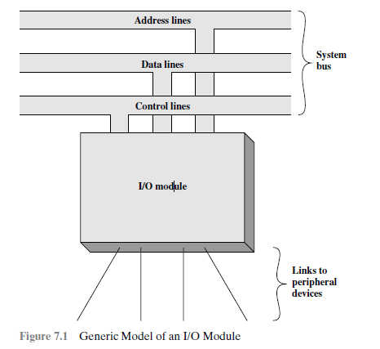

Slide 6
Classify external devices into three categories:
• Human readable: Suitable for communicating with the computer user
• Machine readable: Suitable for communicating with equipment
• Communication: Suitable for communicating with remote devices
Examples of human-readable devices are video display terminals (VDTs) and
printers.
Examples of machine-readable devices are magnetic disk and tape systems,
and sensors and actuators, such as are used in a robotics application
Communication devices allow a computer to exchange data with a remote device, which may be a human-readable device or, a machine-readable device, or even another computer.

Slide 7
The nature of an external device is indicated in Figure 7.2.
The interface to the I/O module is in the form of control, data, and status signals.
Control signals determine the function that the device will perform, such as send data to the I/O module (INPUT or READ), accept data from the I/O module (OUTPUT or WRITE, or perform some control function particular to the device (e.g., position a disk head).
Data are in the form of a set of bits to be sent to or received from the I/O module.
Status signals indicate the state of the device. Examples are READY/NOT-READY to show whether the device is ready for data transfer.

Slide 8
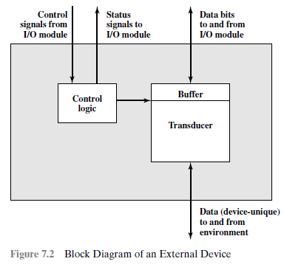

Slide 9
Control logic associated with the device controls the device’s operation in response to direction from the I/O module.
The transducer converts data from electrical to other forms of energy during output and from other forms to electrical during input.
Typically, a buffer is associated with the transducer to temporarily hold data being transferred between the I/O module and the external environment; a buffer size of 8 to 16 bits is common.

Slide 10
Keyboard/Monitor
The basic unit of exchange is the character.
Associated with each character is a code, typically 7 or 8 bits in length.
The most commonly used text code is the International Reference Alphabet (IRA).1
Each character in this code is represented by a unique 7-bit binary code; thus, 128 different characters can be represented.
Characters are of two types: printable and control.
Printable characters are the alphabetic, numeric, and special characters that can be printed on paper or displayed on a screen.
Some of the control characters have to do with controlling the printing or displaying of characters.

Slide 11
Disk Drive
A disk drive contains electronics for exchanging data, control, and status signals with an I/O module plus the electronics for controlling the disk read/write mechanism.
In a fixed-head disk, the transducer is capable of converting between the magnetic patterns on the moving disk surface and bits in the device’s buffer.
A moving-head disk must also be able to cause the disk arm to move radially in and out across the disk’s surface.

Slide 12
I/O MODULES:222
The major functions or requirements for an I/O module are
Control and timing
Processor communication
Device communication
Data buffering
Error detection

Slide 13
I/O MODULES:222
The major functions or requirements for an I/O module are
Control and timing
Processor communication
Device communication
Data buffering
Error detection

Slide 14
Control & Timing
During any period of time, the processor may communicate with one or more external devices in unpredictable patterns, depending on the program’s need for I/O.
The internal resources, such as main memory and the system bus, must be shared among a number of activities, including data I/O.
Thus, the I/O function includes a control and timing requirement, to coordinate the flow of traffic between internal resources and external devices.

Slide 15
The control of the transfer of data from an external device to the processor might involve the following sequence of steps:
1. The processor interrogates the I/O module to check the status of the attached
device.
2. The I/O module returns the device status.
3. If the device is operational and ready to transmit, the processor requests the transfer of data, by means of a command to the I/O module.
4. The I/O module obtains a unit of data (e.g., 8 or 16 bits) from the external device.
5. The data are transferred from the I/O module to the processor.

Slide 16
The I/O module must communicate with the processor and with the external device. Processor communication involves the following:
Command decoding: The I/O module accepts commands from the processor,
typically sent as signals on the control bus.
For example, an I/O module for a disk drive might accept the following commands: READ SECTOR, WRITE SECTOR, SEEK track number, and SCAN record ID.
Data: Data are exchanged between the processor and the I/O module over the
data bus.

Slide 17
Status reporting: Because peripherals are so slow, it is important to know the
Status of the I/O module. For example, if an I/O module is asked to send data to the processor (read), it may not be ready to do so because it is still working
on the previous I/O command. This fact can be reported with a status signal. Common status signals are BUSY and READY
Address recognition: An I/O module must recognize one unique address for
each peripheral it controls.
The I/O module must be able to perform device communication.
This communication involves commands, status information, and data.

Slide 18
An essential task of an I/O module is data buffering.
Data coming from main memory are sent to an I/O module in a rapid burst.
The data are buffered in the I/O module and then sent to the peripheral device at its data rate. In the opposite direction, data are buffered so as not to tie up the memory in a slow transfer operation.
Thus, the I/O module must be able to operate at both device and memory speeds.

Slide 19
An I/O module is often responsible for error detection and for subsequently reporting errors to the processor.
One class of errors includes mechanical and electrical malfunctions reported by the device (e.g., paper jam, bad disk track).
Another class consists of unintentional changes to the bit pattern as it is transmitted from device to I/O module.
Some form of error-detecting code is often used to detect transmission errors.

Slide 20
I/O Module Structure: 223
Figure 7.3 provides a general block diagram of an I/O module.
The module connects to the rest of the computer through a set of signal lines (e.g., system bus lines).
Data transferred to and from the module are buffered in one or more data registers.
There may also be one or more status registers that provide current status information.
A status register may also function as a control register, to accept detailed control information from the processor.

Slide 21
The logic within the module interacts with the processor via a set of control lines.
The processor uses the control lines to issue commands to the I/O module.
The module must also be able to recognize and generate addresses associated with the devices it controls.
Each I/O module has a unique address or, if it controls more than one external device, a unique set of addresses.
An I/O module that takes on most of the detailed processing burden, presenting a high-level interface to the processor, is usually referred to as an I/O channel or I/O processor.
An I/O module that is quite primitive and requires detailed control is usually referred to as an I/O controller or device controller.

Slide 22
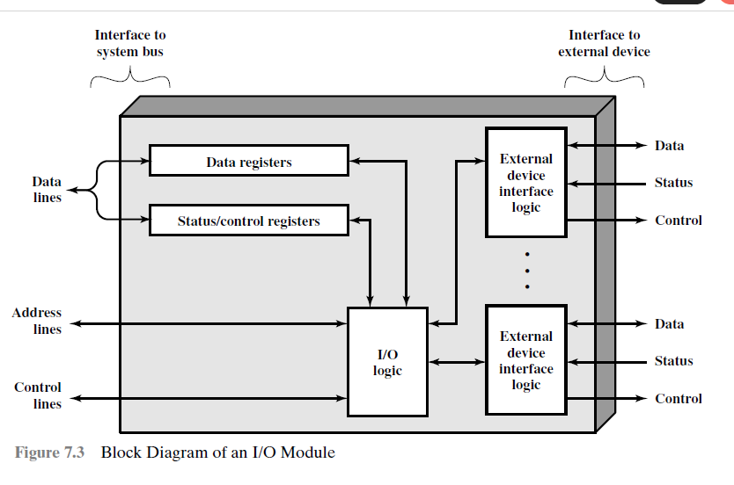

Slide 23
PROGRAMMED I/O: 224
Three techniques are possible for I/O operations.
With programmed I/O, data are exchanged between the processor and the I/O module.
The processor executes a program that gives it direct control of the I/O operation, including sensing device status, sending a read or write command, and transferring the data.
When the processor issues a command to the I/O module, it must wait until the I/O operation is complete.
If the processor is faster than the I/O module, this is wasteful of processor time.

Slide 24
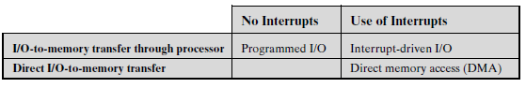
With interrupt-driven I/O, the processor issues an I/O command, continues to execute other instructions, and is interrupted by the I/O module when the latter has completed its work.
With both programmed and interrupt I/O, the processor is responsible for extracting data from main memory for output and storing data in main memory for input.
The alternative is known as direct memory access (DMA).
In this mode, the I/O module and main memory exchange data directly, without processor involvement.

Slide 25
PROGRAMMED I/O: 224
When the processor is executing a program and encounters an instruction relating to I/O, it executes that instruction by issuing a command to the appropriate I/O module.
With programmed I/O, the I/O module will perform the requested action and then set the appropriate bits in the I/O status register (Figure 7.3).
The I/O module takes no further action to alert the processor.
In particular, it does not interrupt the processor.
Thus, it is the responsibility of the processor periodically to check the status of the I/O module until it finds that the operation is complete.

Slide 26
To explain the programmed I/O technique, we have to consider
The I/O commands issued by the processor to the I/O module,
The I/O instructions executed by the processor.
I/O Commands
To execute an I/O-related instruction, the processor issues an address, specifying the particular I/O module and external device, and an I/O command.
There are four types of I/O commands that an I/O module may receive when it is addressed by a processor:

Slide 27
Control:
Used to activate a peripheral and tell it what to do.
For example, a magnetic-tape unit may be instructed to rewind or to move forward one record.
These commands are tailored to the particular type of peripheral device.
Test:
Used to test various status conditions associated with an I/O module and its peripherals.
The processor will want to know that the peripheral of interest is powered on and available for use.
It will also want to know if the most recent I/O operation is completed and if any errors occurred.

Slide 28
• Read: Causes the I/O module to obtain an item of data from the peripheral
and place it in an internal buffer (depicted as a data register in Figure 7.3).
The processor can then obtain the data item by requesting that the I/O module
place it on the data bus.
• Write: Causes the I/O module to take an item of data (byte or word) from the
data bus and subsequently transmit that data item to the peripheral.

Slide 29
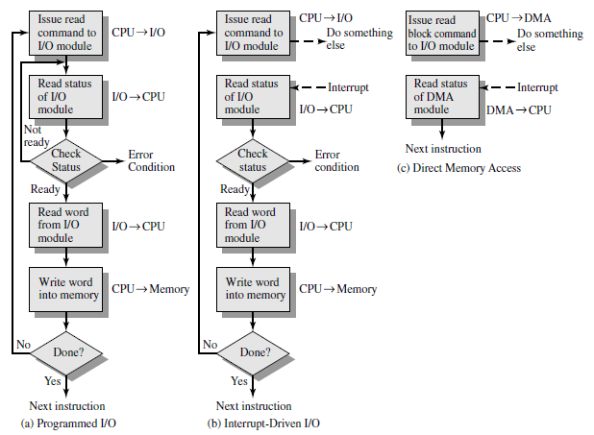
Figure 7.4 Three Techniques for Input of a Block of Data

Slide 30
Figure 7.4a gives an example of the use of programmed I/O to read in a block of data from a peripheral device (e.g., a record from tape) into memory.
Data are read in one word (e.g., 16 bits) at a time.
For each word that is read in, the processor must remain in a status-checking cycle until it determines that the word is available in the I/O module’s data register.
This flowchart highlights the main disadvantage of this technique: it is a time-consuming process that keeps the processor busy needlessly.

Slide 31
I/O Instructions
With programmed I/O, there is a close correspondence between the I/O-related instructions that the processor fetches from memory and the I/O commands that the processor issues to an I/O module to execute the instructions.
That is, the instructions are easily mapped into I/O commands.
There will be many I/O devices connected through I/O modules to the system.
Each device is given a unique address.
When the processor issues an I/O command, the command contains the address of the desired device.
Thus, each I/O module must interpret the address lines to determine if the command is for itself.

Slide 32
Two modes of addressing are possible: memory mapped and isolated.
With memory-mapped I/O, there is a single address space for memory locations and I/O devices.
The processor treats the status and data registers of I/O modules as memory locations and uses the same machine instructions to access both memory and I/O devices.
The address space for I/O is isolated from that for memory, this is referred to as isolated I/O.

Slide 33
INTERRUPT-DRIVEN I/O: 228
The problem with programmed I/O is that the processor has to wait a long time for the I/O module of concern to be ready for either reception or transmission of data.
The processor, while waiting, must repeatedly interrogate the status of the I/O module.
As a result, the level of the performance of the entire system is severely degraded.

Slide 34
INTERRUPT-DRIVEN I/O: 228
An alternative is for the processor to issue an I/O command to a module and then go on to do some other useful work.
The I/O module will then interrupt the processor to request service when it is ready to exchange data with the processor.
The processor then executes the data transfer, as before, and then resumes its former processing.

Slide 35
Let us consider how this works, first from the point of view of the I/O module.
For input, the I/O module receives a READ command from the processor.
The I/O module then proceeds to read data in from an associated peripheral.
Once the data are in the module’s data register, the module signals an interrupt to the processor over a control line.
The module then waits until its data are requested by the processor.
When the request is made, the module places its data on the data bus and is then ready for another I/O operation.

Slide 36
From the processor’s point of view, the action for input is as follows.
The processor issues a READ command.
It then goes off and does something else. (e.g., the processor may be working on several different programs at the same time).
At the end of each instruction cycle, the processor checks for interrupts.
When the interrupt from the I/O module occurs, the processor saves the context (e.g., program counter and processor registers) of the current program and processes the interrupt.
In this case, the processor reads the word of data from the I/O module and stores it in memory.
It then restores the context of the program it was working on (or some other program) and resumes execution.

Slide 37
Figure 7.4b shows the use of interrupt I/O for reading in a block of data.
Compare this with Figure 7.4a. Interrupt I/O is more efficient than programmed I/O because it eliminates needless waiting.
However, interrupt I/O still consumes a lot of processor time, because every word of data that goes from memory to I/O module or from I/O module to memory must pass through the processor.

Slide 38
Interrupt Processing
The occurrence of an interrupt triggers a number of events, both in the processor hardware and in software.
When an I/O device completes an I/O operation, the following sequence of hardware events occurs:
The device issues an interrupt signal to the processor.
2. The processor finishes execution of the current instruction before responding
to the interrupt.
3. The processor tests for an interrupt, determines that there is one, and sends an
acknowledgment signal to the device that issued the interrupt. The acknowledgment
allows the device to remove its interrupt signal.

Slide 39
4. The processor now needs to prepare to transfer control to the interrupt routine.
To begin, it needs to save information needed to resume the current program at
the point of interrupt.
The minimum information required is
(a) the status of the processor, which is contained in a register called the program status word (PSW), and
(b) the location of the next instruction to be executed, which is contained in
the program counter.
These can be pushed onto the system control stack.

Slide 40
5. The processor now loads the program counter with the entry location of the
interrupt-handling program that will respond to this interrupt.
If there is more than one interrupt-handling routine, the processor must determine which one to invoke.
Once the program counter has been loaded, the processor proceeds to the
next instruction cycle, which begins with an instruction fetch.
Thus the control is transferred to the interrupt-handler program.
The execution of this program results in the following operations:

Slide 41
6. At this point, the program counter and PSW relating to the interrupted program
have been saved on the system stack.
The interrupt handler will begin by saving the contents of all registers on the stack.
Figure 7.7a shows a simple example.
In this case, a user program is interrupted after the instruction at location N.
The contents of all of the registers plus the address of the next instruction (N+1) are pushed onto the stack.
The stack pointer is updated to point to the new top of stack, and the program
counter is updated to point to the beginning of the interrupt service routine.

Slide 42
7. The interrupt handler next processes the interrupt.
This includes an examination of status information relating to the I/O operation or other event that caused an interrupt. It may also involve sending additional commands or acknowledgments to the I/O device.
8. When interrupt processing is complete, the saved register values are retrieved from the stack and restored to the registers (e.g., see Figure 7.7b).
9. The final act is to restore the PSW and program counter values from the stack.
As a result, the next instruction to be executed will be from the previously interrupted
program.

Slide 43
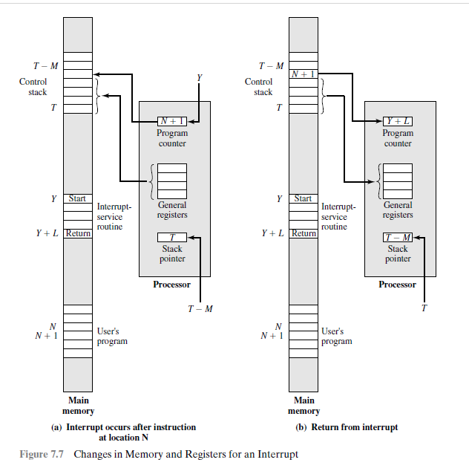

Slide 44
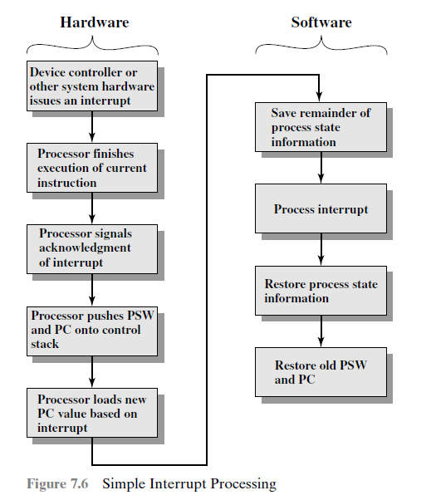

Slide 45
Design Issues
Two design issues arise in implementing interrupt I/O.
Because there will be multiple I/O modules, how does the processor determine which device issued the interrupt?
If multiple interrupts have occurred, how does the processor decide which one to process?

Slide 46
Four general categories of techniques are for device identification:
    • Multiple interrupt lines
    • Software poll
    • Daisy chain (hardware poll, vectored)
    • Bus arbitration (vectored)
The most straightforward approach to the problem is to provide multiple interrupt
lines between the processor and the I/O modules. However, it is impractical.
One alternative is the software poll.
When the processor detects an interrupt, it branches to an interrupt-service routine whose job it is to poll each I/O module to determine which module caused the interrupt.

Slide 47
The poll could be in the form of a separate command line (e.g., TESTI/O).
In this case, the processor raises TESTI/O and places the address of a particular I/O module on the address lines.
The I/O module responds positively if it set the interrupt.
The disadvantage of the software poll is that it is time consuming.
A more efficient technique is to use a daisy chain, which provides, in effect, a hardware poll.

Slide 48
For interrupts, all I/O modules share a common interrupt request line.
The interrupt acknowledge line is daisy chained through the modules.
When the processor senses an interrupt, it sends out an interrupt acknowledge.
This signal propagates through a series of I/O modules until it gets to a requesting module.
The requesting module typically responds by placing a word on the data lines.
This word is referred to as a vector and is either the address of the I/O module or some other unique identifier.

Slide 49
In either case, the processor uses the vector as a pointer to the appropriate device-service routine.
This avoids the need to execute a general interrupt-service routine first.
This technique is called a vectored interrupt.

Slide 50
There is another technique that makes use of vectored interrupts, and that is bus arbitration.
With bus arbitration, an I/O module must first gain control of the bus before it can raise the interrupt request line.
Thus, only one module can raise the line at a time.
When the processor detects the interrupt, it responds on the interrupt acknowledge line.
The requesting module then places its vector on the data lines.

Slide 51
Intel 82C59A Interrupt Controller
The Intel 82C55A Programmable Peripheral Interface

Slide 52
DIRECT MEMORY ACCESS: 236
Drawbacks of Programmed and Interrupt-Driven I/O
Interrupt-driven I/O, is more efficient than programmed I/O, still requires the active intervention of the processor to transfer data between memory and an I/O module, and any data transfer must traverse a path through the processor.
Thus, both these forms of I/O suffer from two drawbacks:
1. The I/O transfer rate is limited by the speed with which the processor can test
and service a device.
2. The processor is tied up in managing an I/O transfer; a number of instructions
must be executed for each I/O transfer
When large volumes of data are to be moved, a more efficient technique is required: direct memory access (DMA).

Slide 53
DMA Function
The DMA module (Figure 7.11) is capable of mimicking the processor and, indeed, of taking over control of the system from the processor.
It needs to do this to transfer data to and from memory over the system bus.
For this purpose, the DMA module must use the bus only when the processor does not need it, or it must force the processor to suspend operation temporarily.
The latter technique is more common and is referred to as cycle stealing, because the DMA module in effect steals a bus cycle.

Slide 54
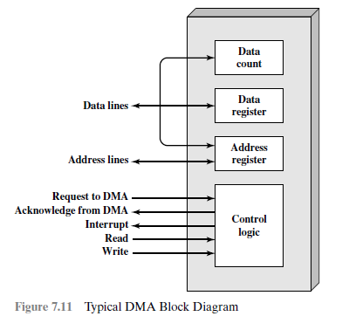

Slide 55
When the processor wishes to read or write a block of data, it issues a command
to the DMA module, by sending to the DMA module the following information:
Whether a read or write is requested, using the read or write control line between the processor and the DMA module
The address of the I/O device involved, communicated on the data lines
The starting location in memory to read from or write to, communicated on the data lines and stored by the DMA module in its address register
The number of words to be read or written, again communicated via the data lines and stored in the data count register

Slide 56
The processor then continues with other work.
The DMA module transfers the entire block of data, one word at a time, directly to or from memory, without going through the processor.
When the transfer is complete, the DMA module sends an interrupt signal to the
processor.
Thus, the processor is involved only at the beginning and end of the transfer (Figure 7.4c).

Slide 57
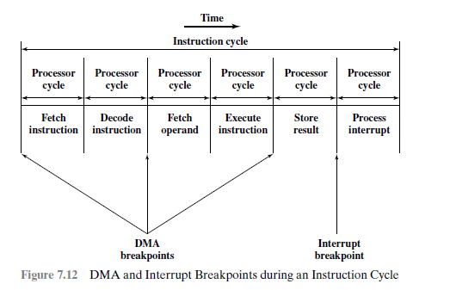

Slide 58
Figure 7.12 shows where in the instruction cycle the processor may be suspended.
In each case, the processor is suspended just before it needs to use the bus.
The DMA module then transfers one word and returns control to the processor.
Note that this is not an interrupt; the processor does not save a context and do something else.
Rather, the processor pauses for one bus cycle.
The overall effect is to cause the processor to execute more slowly.
Nevertheless, for a multiple-word I/O transfer, DMA is far more efficient than interrupt-driven or programmed I/O.

Slide 59
The DMA mechanism can be configured in a variety of ways.
Some possibilities are shown in Figure 7.13.
In the first example, all modules share the same system bus.
The DMA module, acting as a surrogate processor, uses programmed I/O to exchange data between memory and an I/O module through the DMA module.
This configuration, while it may be inexpensive, is clearly inefficient.
As with processor-controlled programmed I/O, each transfer of a word consumes two bus cycles.

Slide 60
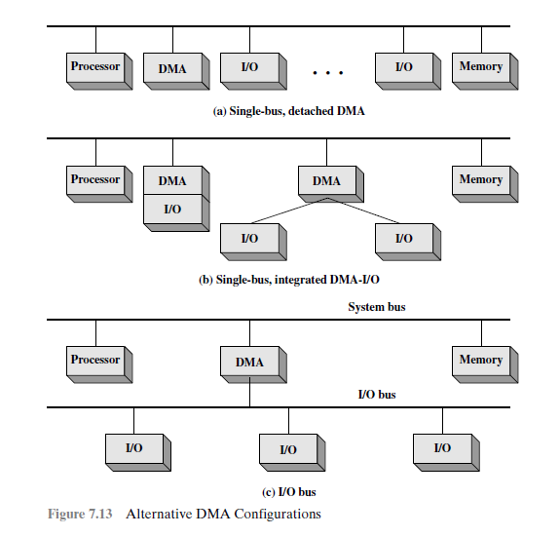

Slide 61
The number of required bus cycles can be cut substantially by integrating the DMA and I/O functions.
As Figure 7.13b indicates, this means that there is a path between the DMA module and one or more I/O modules that does not include the system bus.
The DMA logic may actually be a part of an I/O module, or it may be a separate module that controls one or more I/O modules.
This concept can be taken one step further by connecting I/O modules to the DMA module using an I/O bus (Figure 7.13c).
This reduces the number of I/O interfaces in the DMA module to one and provides for an easily expandable configuration.

Slide 62
Embedded I/O Systems -
Embedded I/O,
General Purpose I/O,
Serial I/O,
Other Peripherals.

Slide 63
Embedded I/O : 565
Embedded systems use a processor to control interactions with the physical environment.
They are typically built around microcontroller units (MCUs) which combine a microprocessor with a set of easy-to-use peripherals.
An embedded system is a system whose user may be unaware there is a computer inside
Examples: Microwave oven
Clock/radio
Electronic fuel injection
Annoying toys with batteries for toddlers
Implantable glucose monitor

Slide 64
An Embedded Input/Output (I/O) System is the part of an embedded system that manages communication between the processor and physical world.
They consist of sensors, actuators, and communication interfaces (e.g., UART, I2C, SPI) to manage real-time tasks in applications like IoT, automotive, and industrial automation.

Slide 65
Key Components
Input Devices: Sensors, switches, and keyboards collect data, while analog-to-digital converters (ADCs) transform real-world analog signals (temperature, pressure) into digital data.
Output Devices: Actuators (motors, relays), displays (LEDs, LCDs), and digital-to-analog converters (DACs) allow the system to control external devices or provide feedback.

Slide 66
Key Components
Communication Interfaces: Serial protocols (UART, I2C, SPI) facilitate communication with other components or systems, while parallel interfaces (PIO) allow for high-speed data transfer.
Processing Core: Microcontrollers (MCUs) or microprocessors are central, frequently using Real-Time Operating Systems (RTOS) to manage tasks and latency

Slide 67
MEMORY-MAPPED I/O
A portion of the address space is dedicated to I/O devices rather than memory.
For example, suppose that physical addresses in the range 0x20000000 to 0x20FFFFFF are used for I/O.
Each I/O device is assigned one or more memory addresses in this range.
A store to the specified address sends data to the device.
A load receives data from the device.
This method of communicating with I/O devices is called memory-mapped I/O.

Slide 68
Embedded I/O : 565
Embedded systems use a processor to control interactions with the physical environment.
They are typically built around microcontroller units (MCUs) which combine a microprocessor with a set of easy-to-use peripherals.
Microcontrollers are generally inexpensive and are designed to minimize system cost and size by integrating most of the necessary components onto a single chip.

Slide 69
RED-V Board: 566
SparkFun RED-V board is an embedded I/O system.
It specifically designed as a development board for testing and deploying applications on a RISC-V microcontroller.
A low-cost, open-source development board featuring the SiFive Freedom E310 SoC.
It uses a familiar Arduino Uno R3 footprint and is ideal for prototyping open-source, royalty-free microcontroller applications.

Slide 70
RED-V Board: 566
Key Features:
Processor: SiFive Freedom E310 (FE310) SoC with a 32-bit RV32IMAC RISC-V core.
Speed: Clock speed exceeding 320 MHz.
Form Factor: Arduino Uno R3 footprint (19 digital I/O pins, 9 PWM pins).
(A form factor defines the physical size, shape, and configuration of hardware components or devices, dictating compatibility, layout, and cooling capabilities)
Memory/Storage: 16KB instruction cache, 16KB data scratchpad.
Connectivity: USB-C connector for programming/debugging (via NXP K22 ARM Cortex-M4), and a Qwiic connector for I2C devices.

Slide 71
FE310-G002 System-on-Chip
The FE310-G002 SoC is a powerful yet inexpensive microcontroller chip designed by SiFive.
It includes a RISC-V microprocessor with a 5-stage pipeline and many I/O Peripherals.

Slide 72
General-Purpose I/O: 568
General-purpose I/O (GPIO) pins are used to read or write digital signals.
GPIO pins require memory-mapped I/O registers to read input pin values, write output pin values.
In many embedded systems, the GPIO pins can be shared with one or more special-purpose peripherals, so additional configuration registers are necessary to determine whether the pin is general- or special-purpose.
The processor may generate interrupts when an event such as a rising or falling edge occurs on an input pin.
The FE310 has 19 GPIO pins

Slide 73
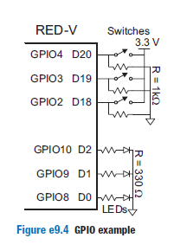
General-Purpose I/O: 568
Figure e9.4 shows three light-emitting diodes (LEDs) and three switches connected to six GPIO pins.
The LEDs are wired to glow when driven to 1 and to turn off when driven to 0.
The current-limiting resistors are placed in series with the LEDs to set the brightness and to avoid overloading the current capability of the GPIO.
The switches are wired to produce a 1 when closed and a 0 when open.

Slide 74
General-Purpose I/O: 568
Table e9.2 lists the GPIO registers and their address offsets relative to the GPIO base address.
Each GPIO pin is mapped to one bit of the registers.
Reading from the input_val (input value) register reads the values of the GPIO pins, and writing to the output_val (output value) register writes to the GPIO pins.
Before reading or writing to the pins, the input and output enable registers (input_en and output_en) must be set to configure the pins as inputs or outputs and the hardware-driven function enable register (iof_en) must be cleared to configure the pins as GPIO controlled.

Slide 75
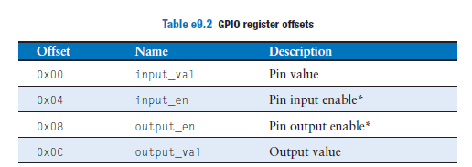

Slide 76
Serial I/O: 577
A microcontroller can send multiple bits to a peripheral device by using multiple wires or by sending multiple bits in series over a single wire.
The former is called parallel I/O and the latter is called serial I/O.
Serial I/O is popular, especially when pins are limited, because it uses few wires and is fast enough for many applications.
Many standards for serial I/O have been established and microcontrollers offer dedicated hardware to easily send data via these standards.
The SPI and UART are standard serial interfaces.
Other common serial standards include inter-integrated circuit (I²C), universal serial bus (USB), and Ethernet.

Slide 77
Serial Peripheral Interface (SPI)
SPI (pronounced “S-P-I”) is a simple synchronous serial protocol that is easy to use and relatively fast.
The physical interface consists of three pins: serial clock (SCK), serial data out (SDO), and serial data in (SDI).
SPI connects a controller device to a peripheral device, as shown in Figure e9.6(a).
The controller produces the clock.
It initiates communication by sending clock pulses on SCK.

Slide 78
Serial Peripheral Interface (SPI)
The controller sends data from its SDO pin to the peripheral’s SDI pin one bit per cycle, starting with the most significant bit.
The peripheral may simultaneously respond with its SDO pin back to the controller’s SDI pin.
Figure e9.6(b) shows the SPI waveforms for an 8-bit data transmission.
Bits change on the falling edge of SCK and are stable to sample on the rising edge.
The SPI interface may also send an active-low chip enable to alert the receiver that data is coming.

Slide 79
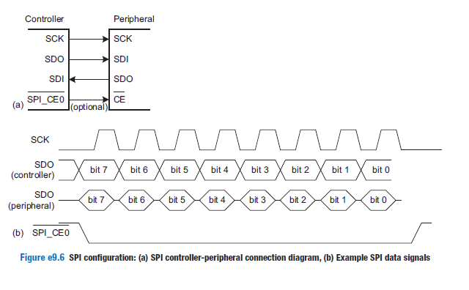

Slide 80
Universal Asynchronous Receiver/Transmitter (UART): 586
A UART (pronounced “you-art”) is a serial I/O peripheral that communicates
between two systems without sending a clock.
It is not a communication protocol like SPI, but a physical circuit.
A UART’s main purpose is to transmit and receive serial data.
UART transmit asynchronously, which means there is no clock signal.
It has only two wires to receive and transmit data.

Slide 85
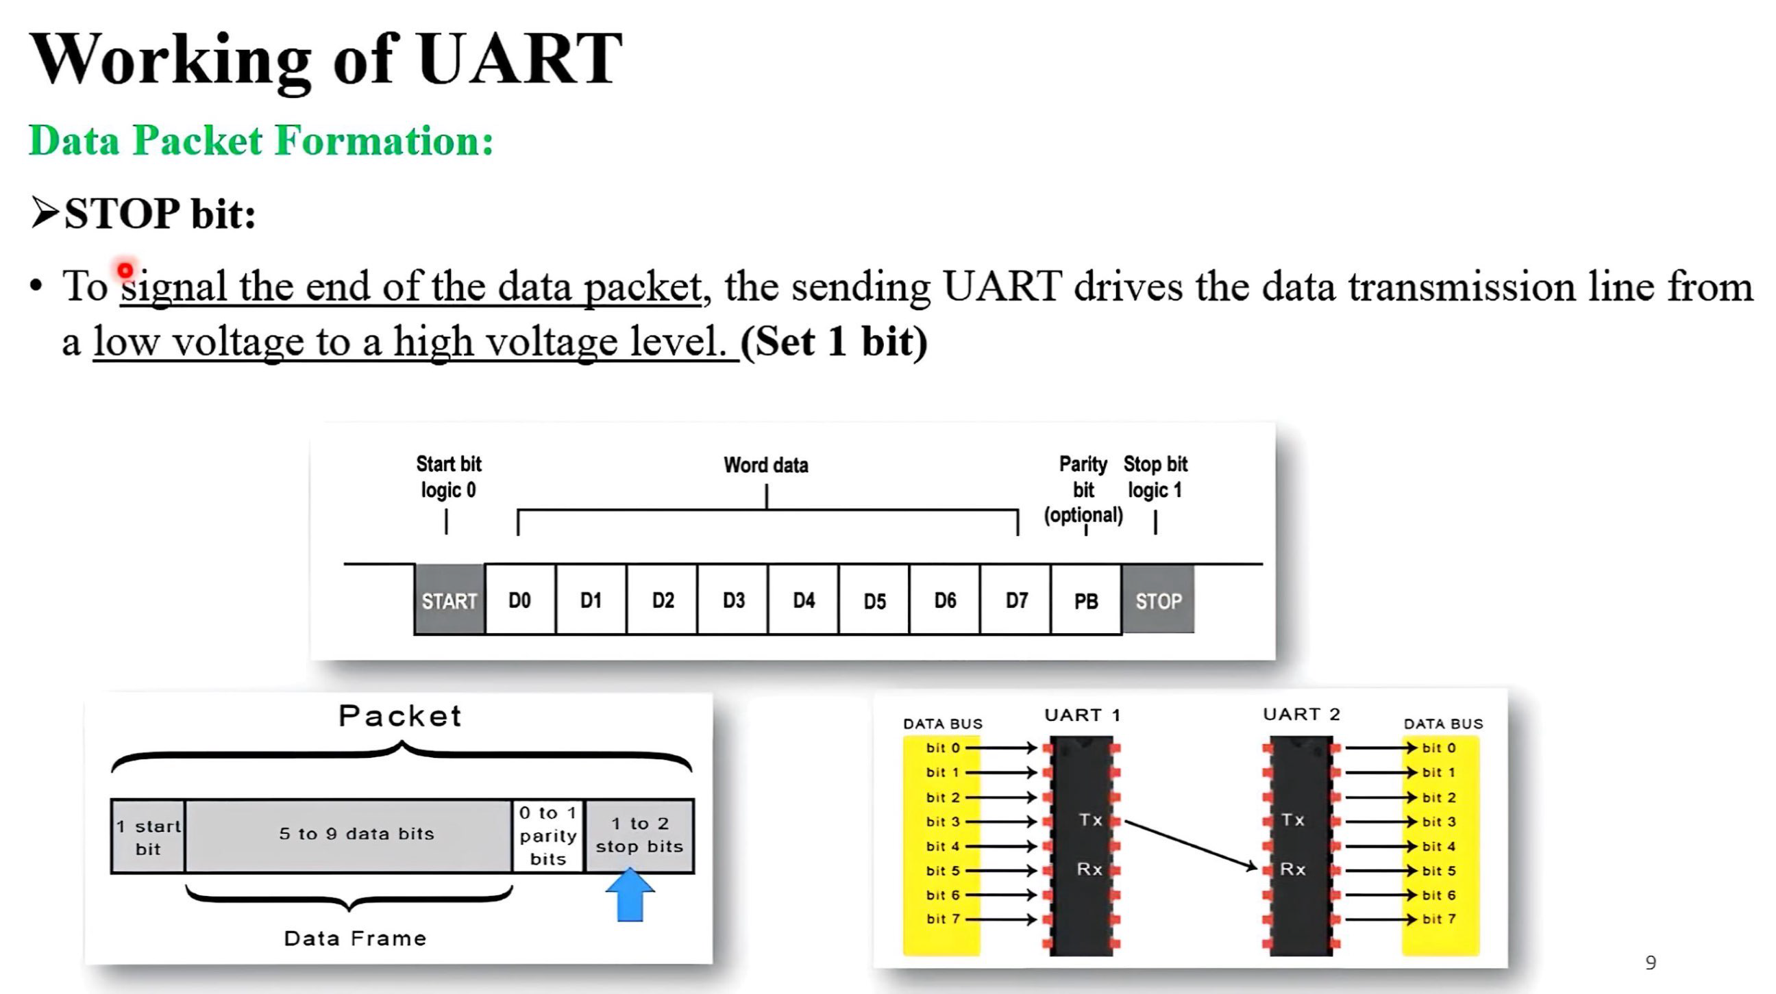

Slide 86
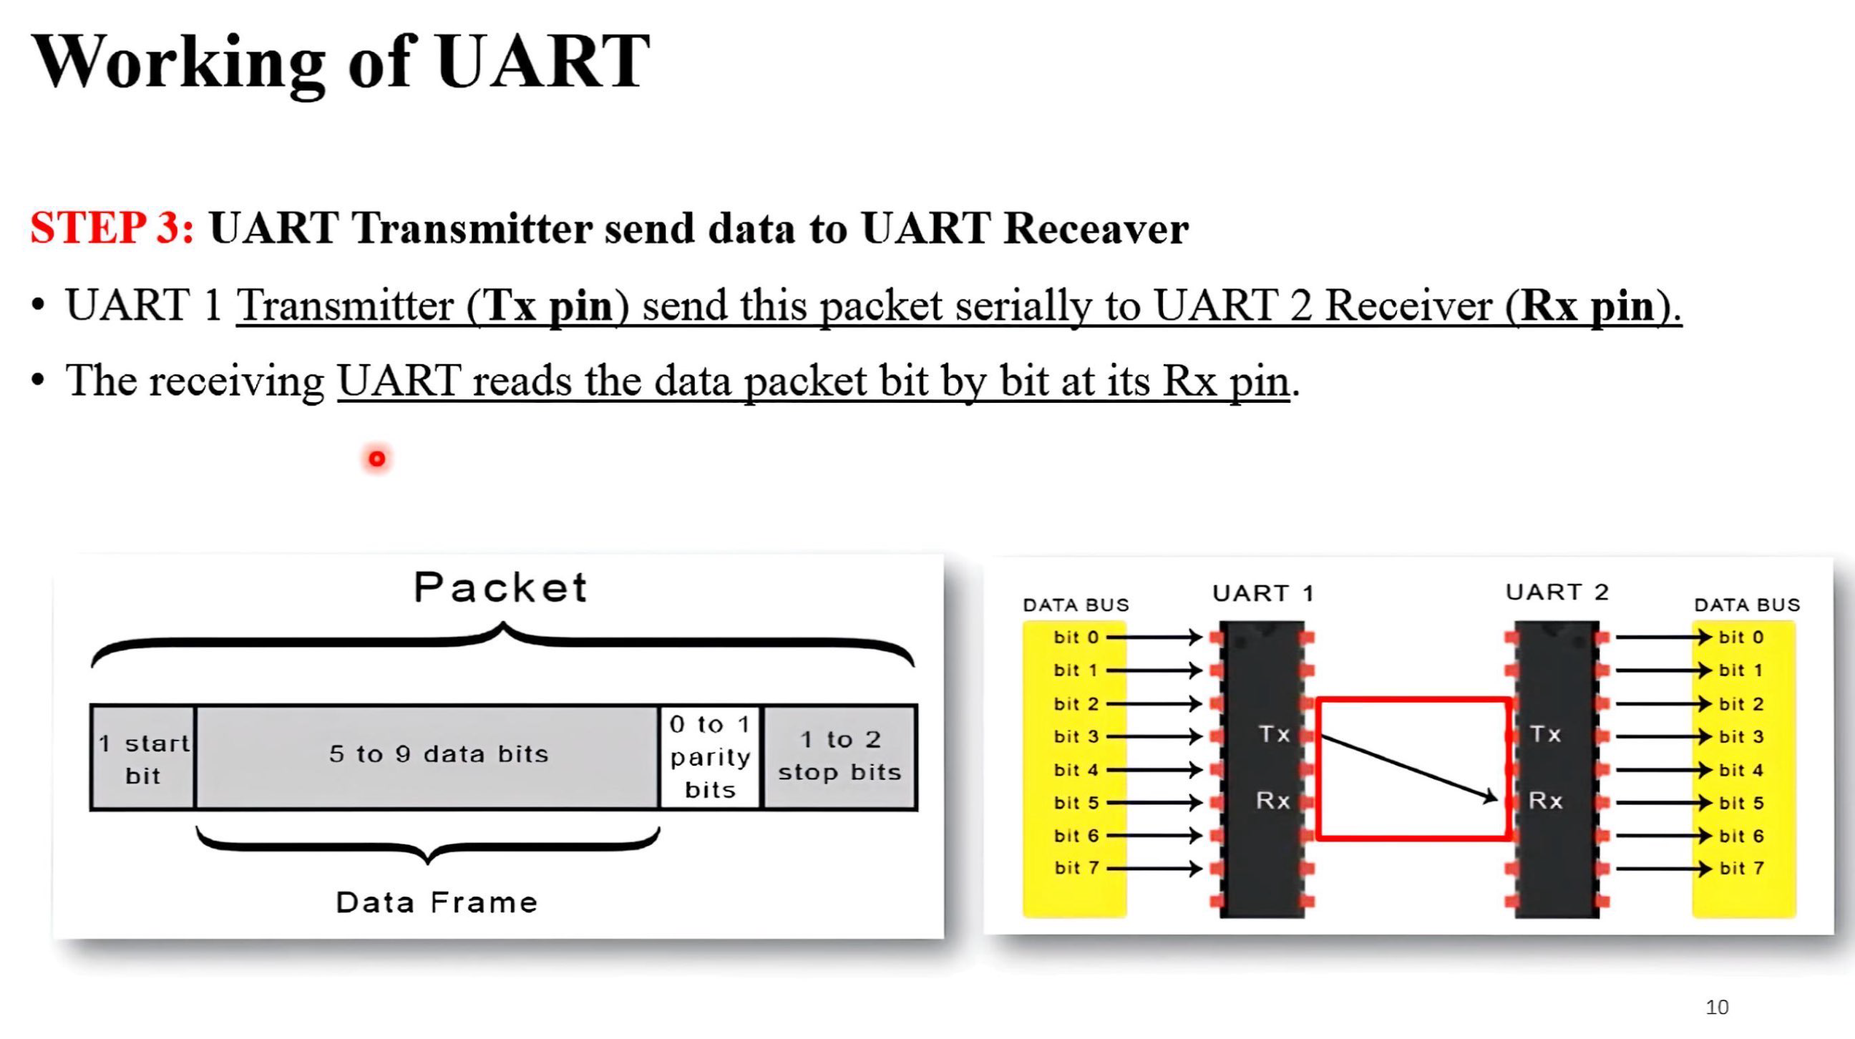

Slide 87
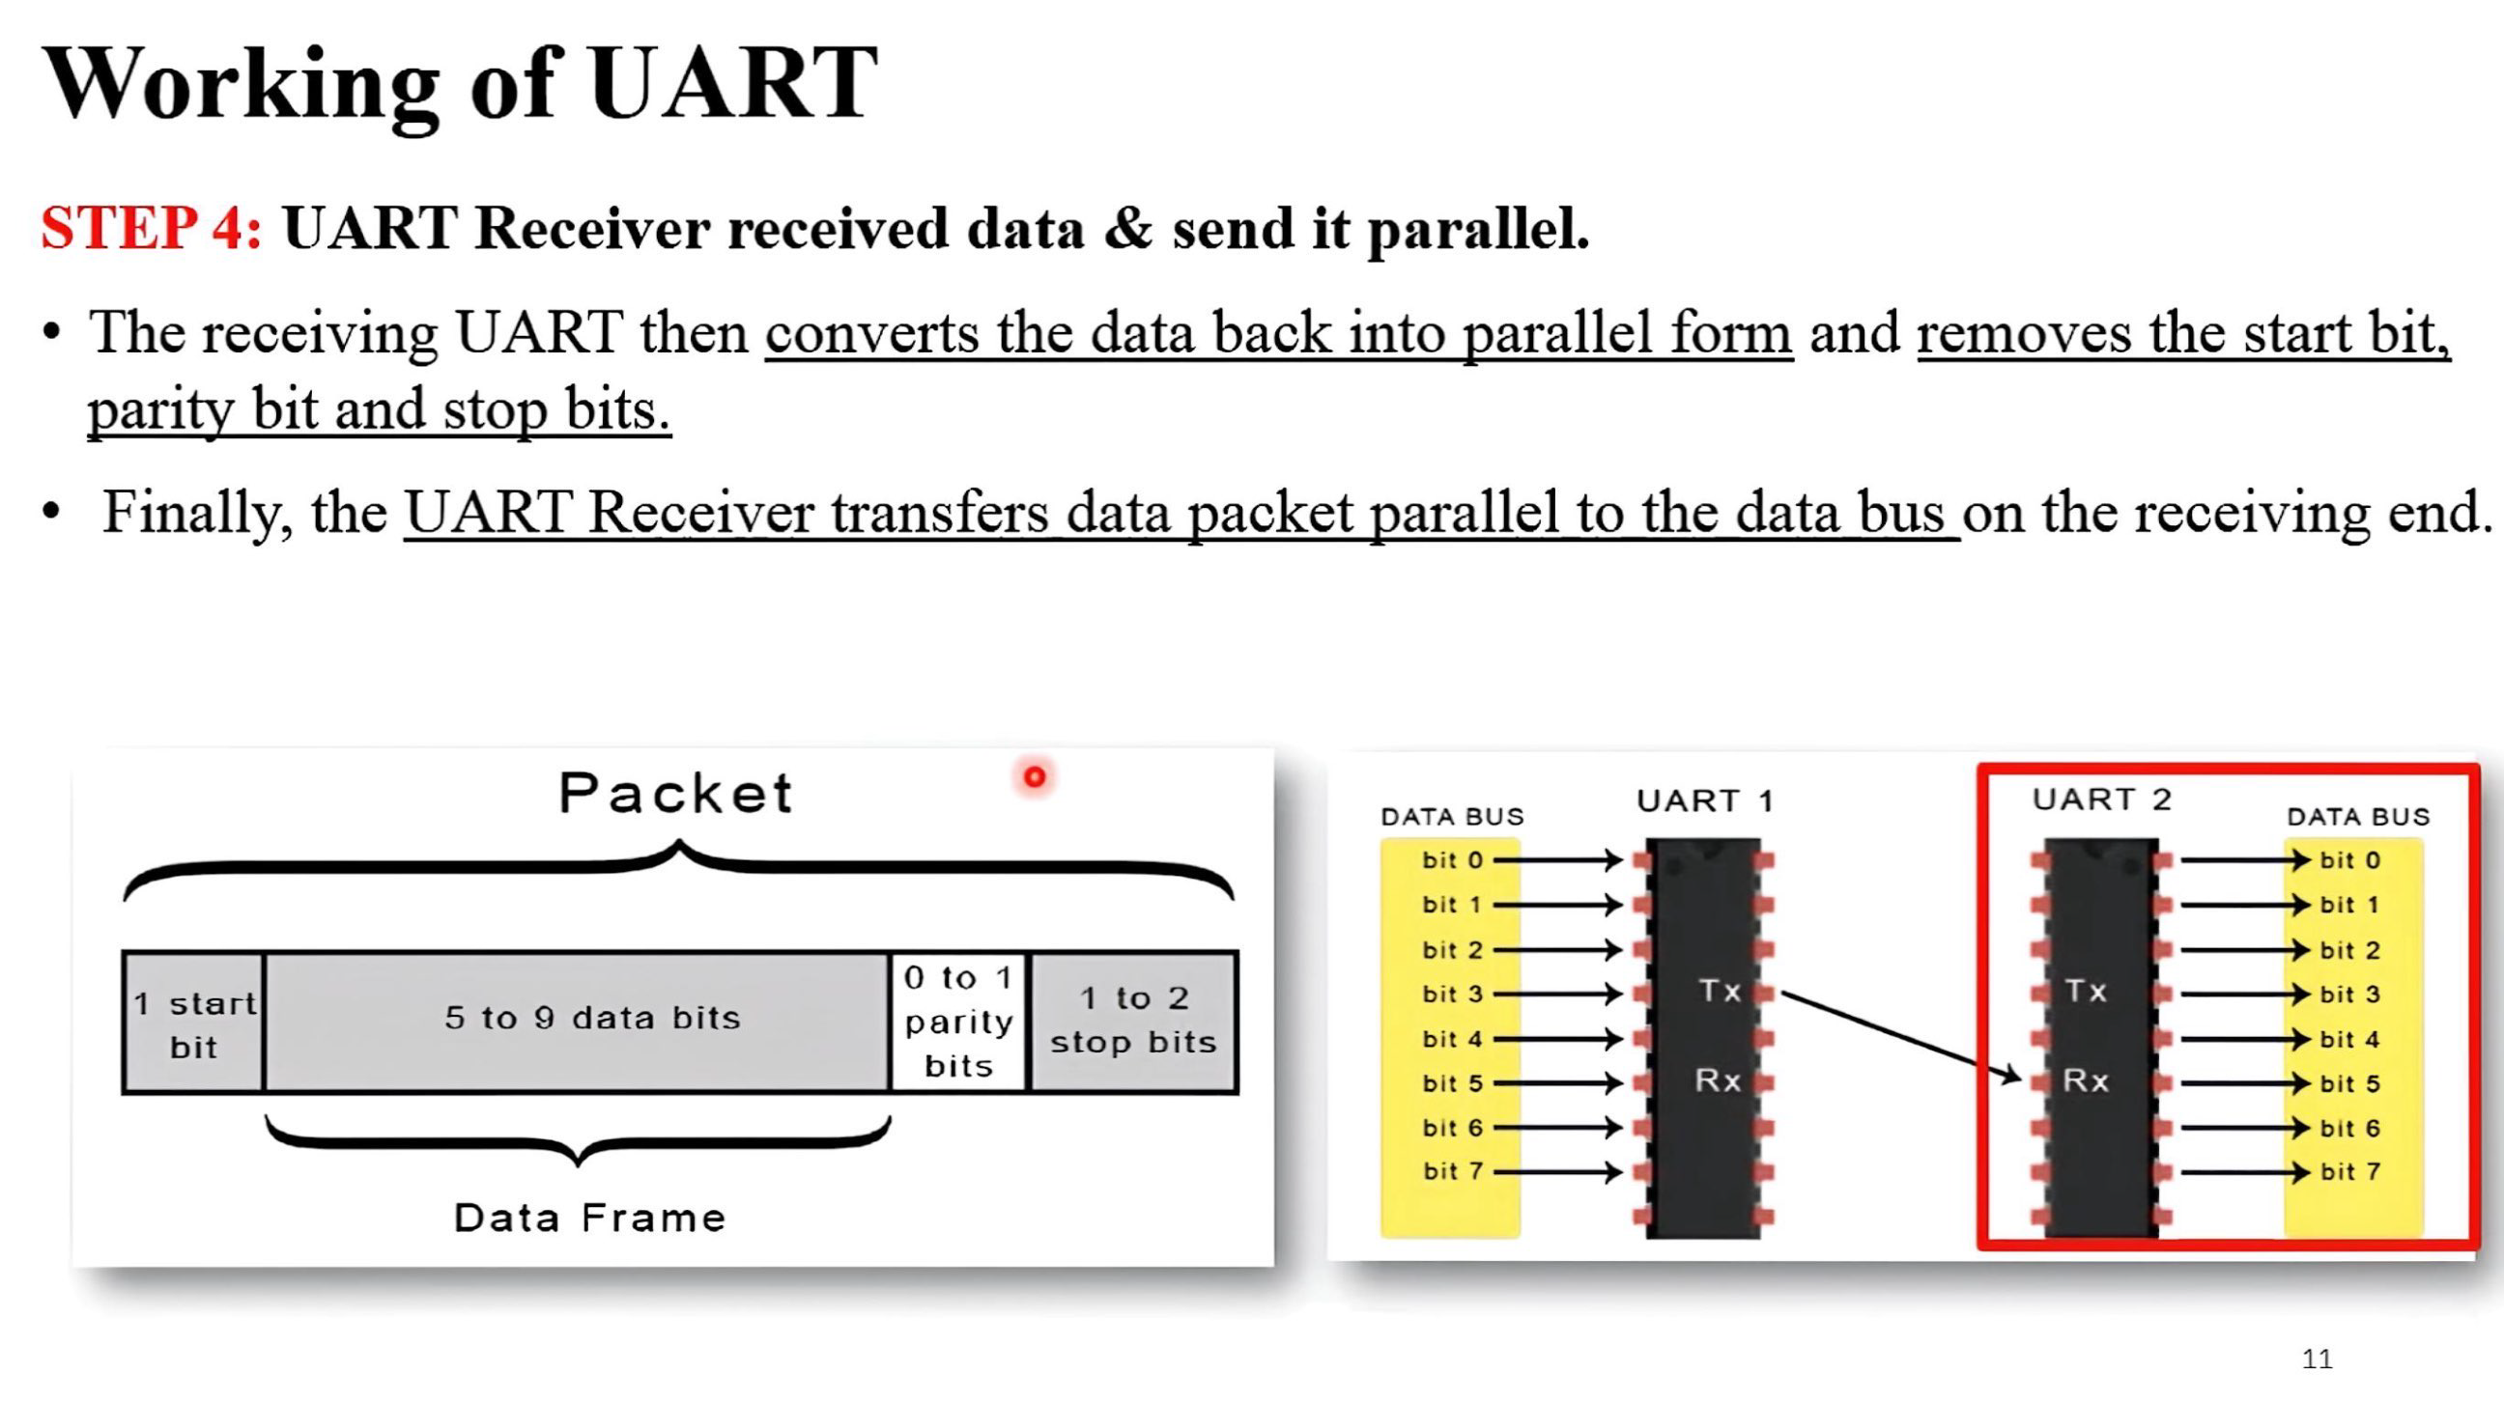

Slide 88
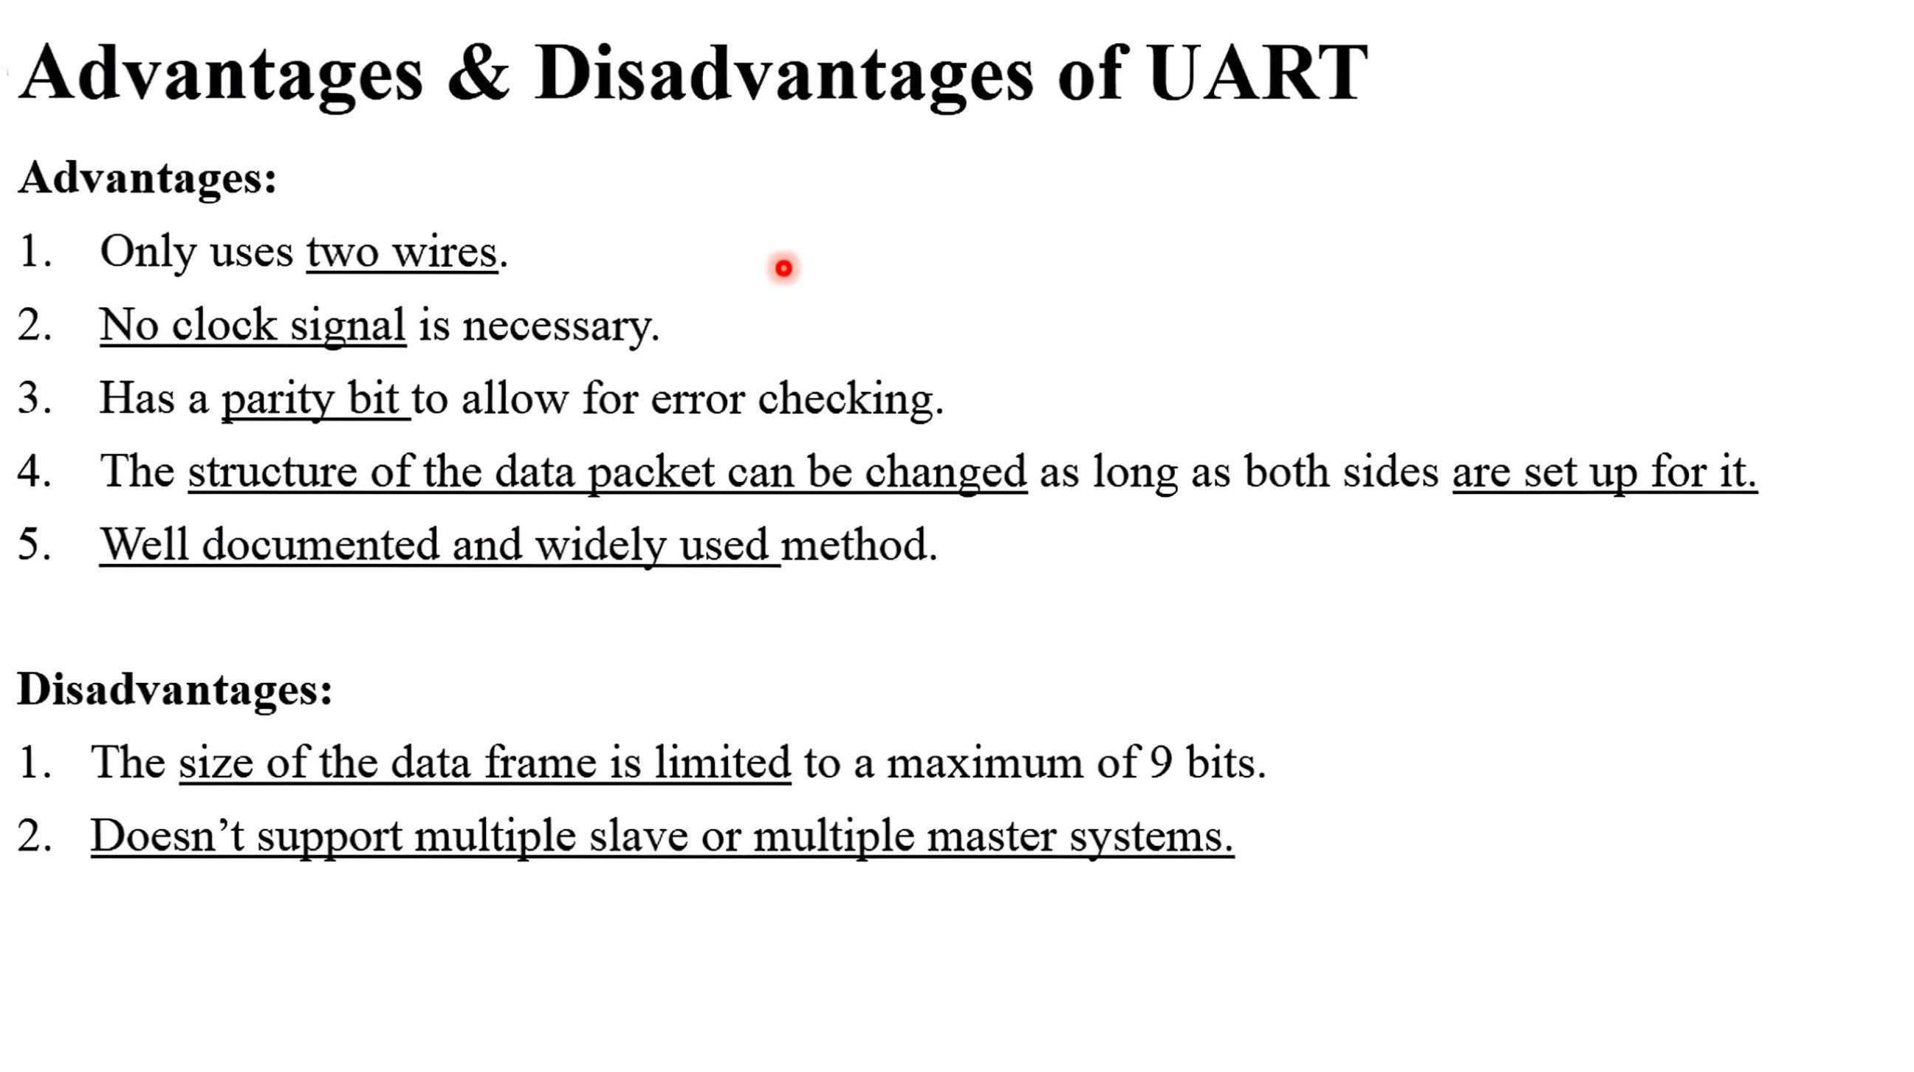

Slide 89
OTHER MICROCONTROLLER PERIPHERALS: 606
Character LCDs:
A character LCD is a small liquid crystal display capable of showing one or a few lines of text.
They are commonly used in the front panels of appliances such as cash registers, laser printers, and fax machines that need to display a limited amount of information.
They are easy to interface with a microcontroller over parallel, RS-232, or SPI interfaces.

Slide 90
OTHER MICROCONTROLLER PERIPHERALS: 606
VGA Monitor:
A more flexible display option is to drive a computer monitor.
A VGA (video graphics array) monitor.
The VGA monitor standard was introduced in 1987 for the IBM PS/2 computers, with a 640 × 480 pixel resolution on a cathode ray tube (CRT) and a 15-pin connector conveying color information with analog voltages.

Slide 91
OTHER MICROCONTROLLER PERIPHERALS: 606
In a CRT, an electron gun scans across the screen from left to right, exciting fluorescent material to display an image.
Color CRTs use three different phosphors for red, green, and blue, and three electron beams.
The strength of each beam determines the intensity of each color in the pixel.
At the end of each scan line, the gun must turn off for a horizontal blanking interval to return to the beginning of the next line.
After all of the scan lines are complete, the gun must turn off again for a vertical blanking interval to return to the upper left corner.
This entire process repeats about 60 to 75 times per second to refresh the fluorescence and give the visual illusion of a steady image. Modern displays typically use LCD technology, which doesn’t require the same electron scan gun but uses the same VGA interface timing for compatibility.

Slide 92
OTHER MICROCONTROLLER PERIPHERALS: 606
Bluetooth Wireless Communication:
Many standards are now available for wireless communication, including Wi-Fi, ZigBee, and Bluetooth.
BlueSMiRF is an easy-to-use Bluetooth wireless interface that can be used instead of a serial cable.
Bluetooth is a wireless standard initially developed by Ericsson in 1994 for low-power, moderate-speed communication over distances of 5 to 100 meters, depending on the transmitter power level.
It is commonly used to connect an earpiece to a cellphone or a keyboard to a computer.

Slide 93
OTHER MICROCONTROLLER PERIPHERALS: 606
Motor Control:
Three types of motors: DC motors, servo motors, and stepper motors.
DC motors require a high drive current, typically on the order of 1 A.
Thus, a microcontroller’s GPIO cannot drive them directly and a powerful driver such as an H-bridge must be connected between the microcontroller and the motor.
Motors also require a shaft encoder if the user wants to know the current position of the motor.

Slide 94
OTHER MICROCONTROLLER PERIPHERALS: 606
Servo motors accept a pulse-width modulated signal to specify their position over a limited range of angles.
They are very easy to interface but are not as powerful and are not suited to continuous rotation.
Stepper motors accept a sequence of pulses, each of which rotates the motor by a fixed angle, called a step.
They are more expensive and still need an H-bridge to drive the high current, but the position can be precisely controlled.

Slide 95
END

